Slide 1
COVID-19 Tracking app
Raneem Soufi
002-49-2884

Slide 2
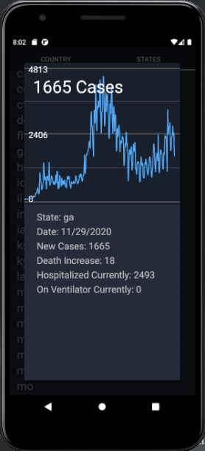
Introduction
COVID-19 Tracking: API from “The COVID tracking project”
Entire country
State by state
Data provided
Line graph
State, date of last report
Increase in number of cases
Death increase
Number of people on a ventilator
Number of people currently hospitalized
Notes:
Slide 2: high
-
level introduction of the App

Slide 3
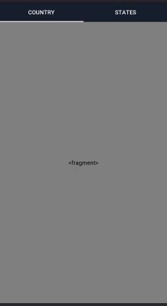
Architecture
UI
TabLayout
TableLayout
Fragment
PopUp
Graph (extends View)
Custom Classes
State (implements Runnable, Serializable)
Country (implements Runnable, Serializable)
Volley
RequestQueue
Main Activity
Notes:
Slide 3: overall design architecture of your
application
showing different component

Slide 4
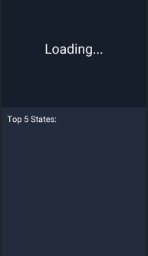

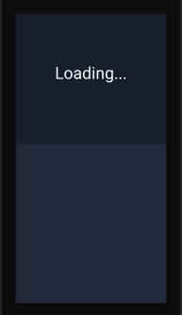
(Table view loaded at runtime)
(Table view loaded at runtime)
(Table view loaded at runtime)
Main Fragment
State Fragment
State PopUp Fragment

Slide 5
OS Level Functionality
ThreadPoolExecutor
Handler
Notes:
lide 4: OS
-
level functionalities description and APIs/System Cal

Slide 6
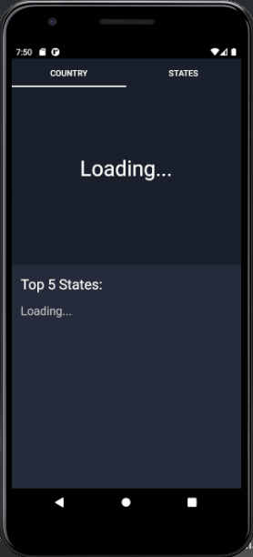
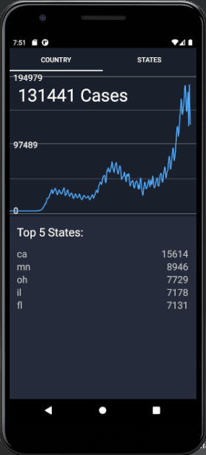
Demo
Before data fully loaded in
After data fully loaded in

Slide 7
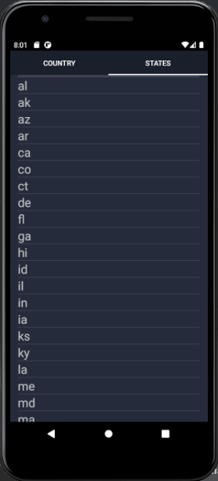
Demo
Popup

